Slide 1
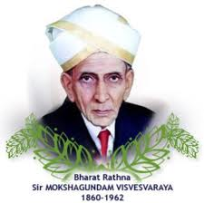
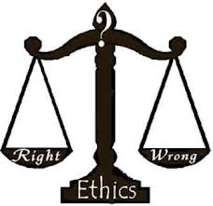
ENGINEERING ETHICS

Slide 2
WHAT IS ENGINEERING ETHICS?
Engineering ethics is a body of philosophy indicating the ways that engineers should conduct themselves in their professional capacity

Slide 3
Variety of moral issues
types of inquiry moral dilemmas
moral autonomy
The problems of Many Hands
Kohlburg’s theory
Gilligan’s theory Impediments to Responsible Action.

Slide 4
BASIC CONCEPT OF ENGINEERING ETHICS
The products that are manufactured are to be
Given due attention in respect of
Safety
Health
Welfare of the people
Environment

Slide 5
DEFINITION OF ENGINEERING ETHICS
Study of moral issues and decision confronting the engineers, organisations in engineering
Study of related questions about the moral ideals, character, policies and relationships between the people and corporations involved in technical activities

Slide 6
VARIETY OF MORAL ISSUES
Engineering disasters caution about safety beyond the level of acceptable risk.
Eg: Gas leak at chemical plant-Union Carbide Plant-Bhopal
Ethics are two approaches
Micro Ethics: Means everyday problem faced by Engineer in his life or in engineering office
Macro Ethics: Means the problems that resurface on an regional level or national level

Slide 7

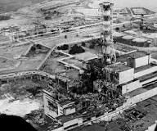
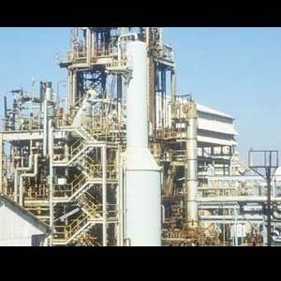
ENGINEERING DISASTERS
The Challenger explosion
The accidents at Nuclear Power Plant at
Chernobyl-Russia
Gas leak at Chemical Plant
Bhopal

Slide 8
THE VARIOUS BODIES WITH WHICH ENGINEERS MAY FACE PROBLEMS VARIOUS BODIES WITH WHICH ENGINEERS MAY FACE PROBLEMS
GLOBAL ENVIRONMENT
W
FAMILY
ENGINEERS
MANAGERS
COLLEGUES
INDUSTRY
,OTHER FIRMS
ENGG,
PROFESSIONAL SOCIETIES
CLIENTS
CUSTOMERS
LAW,PUBLIC AGENCIES

Slide 9
TYPES OF ENQUIRY
Inquiry means, conducting a detailed survey about the project or a product to know its pros and cons, when they are put in use to identify the values that will be able to guide professionals. Inquiries are
Normative inquiry
Conceptual inquiry
Factual inquiry

Slide 10
NORMATIVE INQUIRY
How far the engineers are mobilised to protect the public safety in a given situation?
Whose values are to be given importance primarily in making judgments about the risks involved in a design for public transport system, wherein Govt., engineers and citizens are involved

Slide 11
CONCEPTUAL INQUIRIES
Concepts, principles and issues in Engineering ethics.
For example
What does “Safety” mean?
How Safety is related to “Risk”?
What does it mean when codes of Ethics say Engineers should do and should not do?
Protective Safety, Health and welfare of the people?

Slide 12
FACTUAL INQUIRIES
The factual inquiries are descriptive inquiries
Give information that has got bearing upon values issues
Give information about the facts on business that are in practice during the same time
Thus the three inquiries help to understand the business, social and political facts in which the company operates.

Slide 13
MORAL DILEMMAS
Moral dilemma are situations in which two or more obligations, duties, rights, goods or ideals come into conflict with one and other
Three sorts of situations that are involved in moral dilemmas are as follows
Problems of Vagueness
Problems of Conflicting reasons
Problems of disagreement

Slide 14
PROBLEMS OF VAGUENESS
As far as engineer concerned there is considerable vagueness about whether the gift is an acceptable article or unacceptable bribe
PROBLEMS OF CONFLICTING REASONS
Conflict about the morals to be applied under given conditions
PROBLEMS OF DISAGREEMENT
Disagreement over interpreting and implementing under particular situation

Slide 15
MORAL AUTONOMY
Moral autonomy means “Self determining” or “ Independent”
Moral autonomy means the skill and habit of thinking rationally about ethical issues, based on moral binding
The study of engineering ethics will strength our commitments towards honesty, respect for colleagues, safety and concern for public good

Slide 16
THEORIES ON MORAL AUTONOMY
Lawarance Kohlberg’s Theory
Carol Gilligan’s Theory

Slide 17
Lawarance Kohlberg’s Theory
There are three level of moral developments
Pre-conventional level-the individual is interested in things which directly benefit oneself.
Conventional level-The concept of conventional level is to follow accepted norms and satisfy expectation of others
Post-conventional level-The concept of Pre-conventional level is to follow Golden Rule namely ” Do to others as you expect others to do to you”

Slide 18
CAROL GILLINGAN’S THEORY
Pre-Conventional Level
A person views what is good for one self
Conventional level
A person willing to sacrifice his own interests in order to help others especially woman
Post –Conventional Level
A person strikes a reasoned balance between caring about other people and pursuing one’s own self-interest

Slide 19
MODELS OF PROFESSIONAL ROLES
Engineers have to play the role of “Professional Models” in promoting the public good, the public safety and welfare. An engineer should be
Saviour-Create an ideal society
Guardian- to develop technology
Bureaucratic servant-Service as a Govt., employee
Social Servant-Servant to the public

Slide 20

THANK YOU
“The quality of a person’s life is in direct proportion to their commitment to excellence, regardless of their chosen field of endeavor.” Vince Lombardi

Slide 21
THANK YOU

